Slide 1
Predictive Flood Modeling for Resilient Communities in Sierra Leone.
Frontier Tech Leaders Programme Global Cohort 1
Steven Daniel
11/12/2023

Slide 2
Outline
Frontier Tech Leaders Programme Global Cohort 1
Concept note and implementation plan:
Background
Objectives
SDG Relation
Data
Data Collection
Exploratory Data Analysis (EDA) and Feature Engineering
Model Selection and Training
Model Evaluation and Hyperparameter Tuning
Model Refinement and Testing
Results
Deployment
Future Work

Slide 3
Concept note and implementation plan
Frontier Tech Leaders Programme Global Cohort 1

Slide 4
Background
Frontier Tech Leaders Programme Global Cohort 1
The project focuses on developing a flood prediction model for Sierra Leone.
Frequent incident of flooding
Loss of lives and properties
The primary objective is to facilitate swift measures for mitigating the impact on communities and critical infrastructure
Devastating floods wreak havoc on vulnerable communities and critical infrastructure
August 14, 2017, mudslide– over 400 dead, 3,000 homeless, over 600 missing
Project is important to lessen the devastating effects of flooding on infrastructure, agriculture, and communities.
Leverage machine learning for flood prediction.

Slide 5
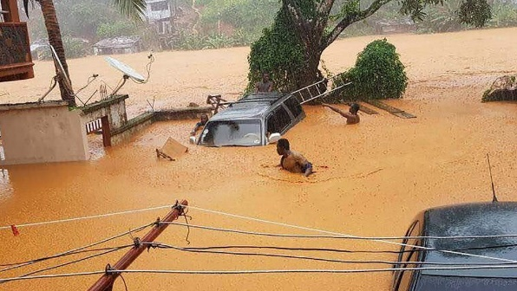
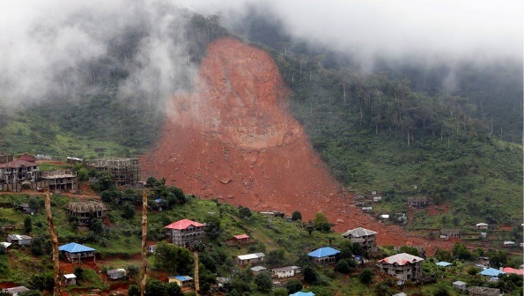
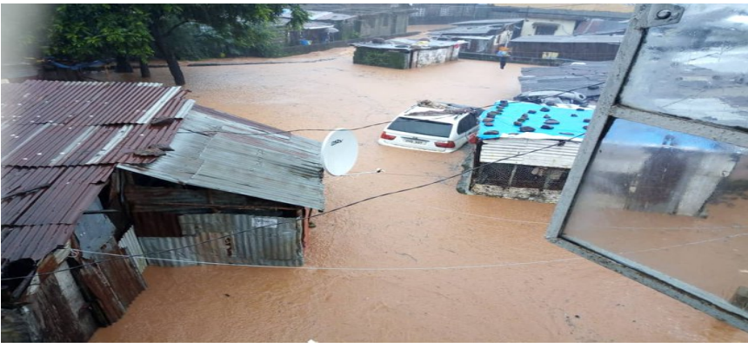
Background

Slide 6
Objectives
Frontier Tech Leaders Programme Global Cohort 1
Aggregate and preprocess data to establish a robust foundation for the flood prediction model
Utilize machine learning algorithms to interpret complex relationships within the dataset, enhancing prediction accuracy and reliability.
Evaluate and select appropriate technologies and tools for data analysis, and machine learning in enhancing the precision and scalability of the flood prediction model
Validate the machine learning model using historical data and optimize parameters for improved performance
Create an intuitive interface for end-users to access and interpret flood predictions

Slide 7
SDG Relation
Frontier Tech Leaders Programme Global Cohort 1
SDG 11 – Sustainable Cities and Communities
Swift measures based on accurate predictions can minimize the impact of floods on urban areas, protecting both lives and infrastructure.
SDG 13 – Climate Action
Mitigating the effects of floods, a consequence intensified by climate change through accurate predictions supports the broader goal of climate resilience
SDG 9 – Industry, Innovation, and Infrastructure
represents a technological innovation that contributes to the advancement of infrastructure resilience.
SDG 1 – No Poverty (Indirectly related)
Protecting communities from floods helps safeguard livelihoods, prevent economic loss, and contributes to overall poverty reduction
Notes:
By integrating data-driven insights, the project aligns with the goal of fostering sustainable and resilient infrastructure development.

Slide 8
Data
Frontier Tech Leaders Programme Global Cohort 1

Slide 9
Data Collection
Frontier Tech Leaders Programme Global Cohort 1
Source(s) of the dataset: OpenWeather Map
https://home.openweathermap.org/marketplace/my_orders
Preprocessing steps during data collection
Identify missing rows using .isnull().sum() functions
Handled missing values using fillna() using median imputation
Perform summary statistics using .describe() function
Time series transformation
One hot encoding to encode categorical data
Time series transformation

Slide 10
Exploratory Data Analysis (EDA) and Feature Engineering
Frontier Tech Leaders Programme Global Cohort 1
Computation of summary statistics for key variables.
Created a correlation matrix and visualized it using a heatmap.
Plotted pair plots of features to gain insights into the structure, relationships, and patterns within the dataset.
Created rain as a feature by combining rain_1h and rain_3h
Created flood_occurred as a target variable by setting a threshold of rainfall.
Perform one hot and label encoding on data
No scaling of features – model insensitivity to feature scale, features have similar scales

Slide 11
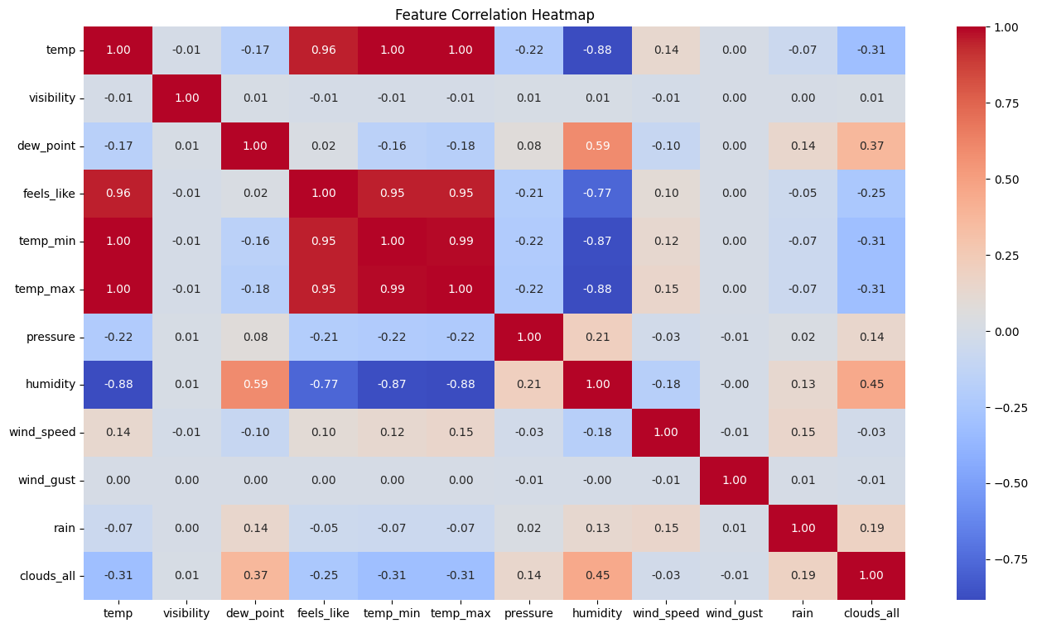
Exploratory Data Analysis (EDA) and Feature Engineering
Frontier Tech Leaders Programme Global Cohort 1

Slide 12
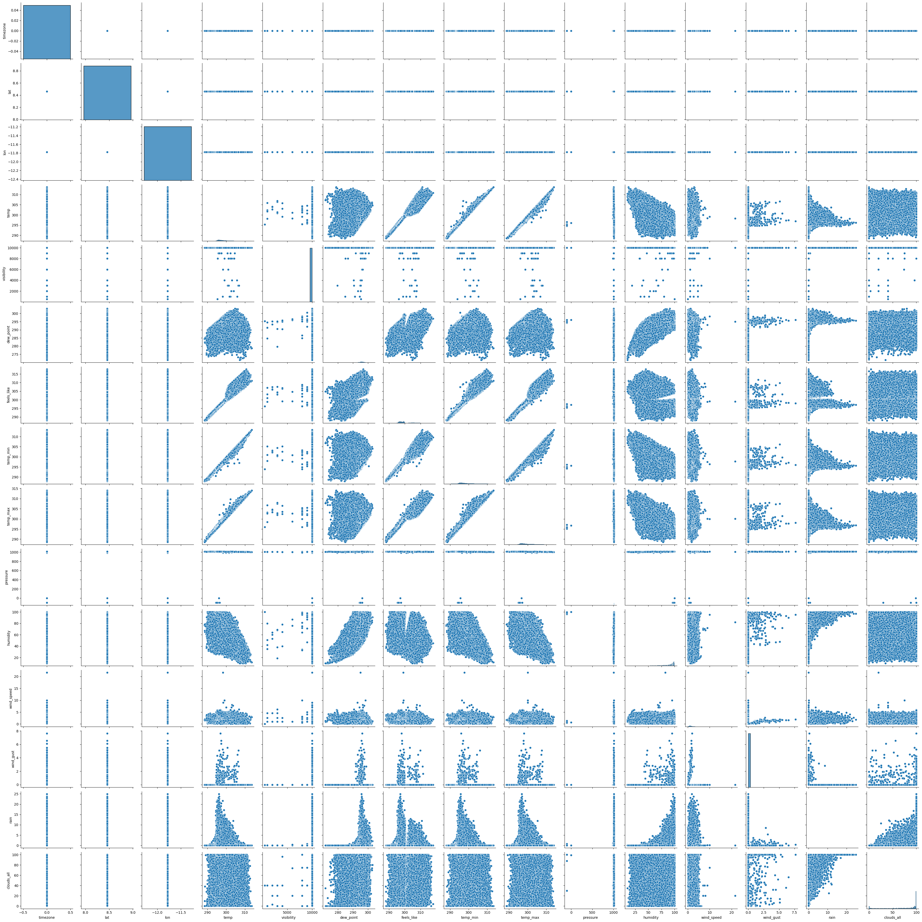
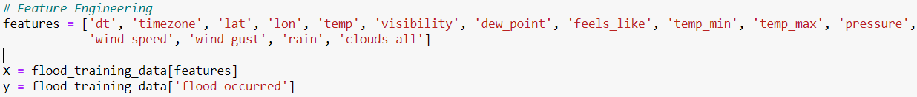
Exploratory Data Analysis (EDA) and Feature Engineering
Frontier Tech Leaders Programme Global Cohort 1

Slide 13
Model
Frontier Tech Leaders Programme Global Cohort 1

Slide 14
Model Selection and Training
Frontier Tech Leaders Programme Global Cohort 1
Logistic Regression - provides a simple, interpretable model, allowing for a clear understanding of the relationship (weather features and flood likelihood).
Strengths:
Easy to interpret and understand.
Fast training and prediction times, particularly beneficial for large datasets
Weaknesses
Assumes a linear relationship, potentially limiting its ability to capture complex non-linearities
May not perform as well when the relationship between features and target is highly non-linear.

Slide 15
Model Selection and Training
Frontier Tech Leaders Programme Global Cohort 1
Neural Network (Multilayer Perceptron (MLP) - ability to model complex relationships in data capable of learning complex patterns and representations from data.
Strengths:
can adapt to different types of data and learn hierarchical representations, making them versatile for various tasks
automatically learn relevant features from the input data, reducing the need for extensive manual feature engineering
neural networks can generalize well to unseen data, avoiding overfitting
Weaknesses
computationally intensive and time-consuming.
often require a large amount of labeled data to perform well and avoid overfitting..

Slide 16
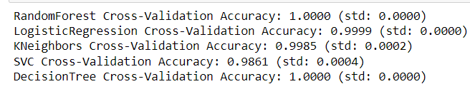
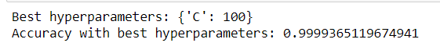
Model Selection and Training
Frontier Tech Leaders Programme Global Cohort 1
The model was trained on 80% and test on 20% of the dataset
Random state of None was set
K-fold for initial training
Stratified k-fold for refinement
Scaling of the X features using StandardScaler()
Hyperparameter tuning using GridSearchCV

Slide 17
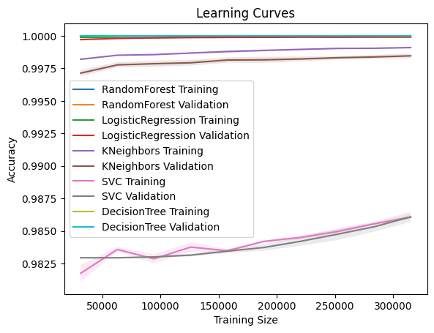
Model Selection and Training
Frontier Tech Leaders Programme Global Cohort 1

Slide 18
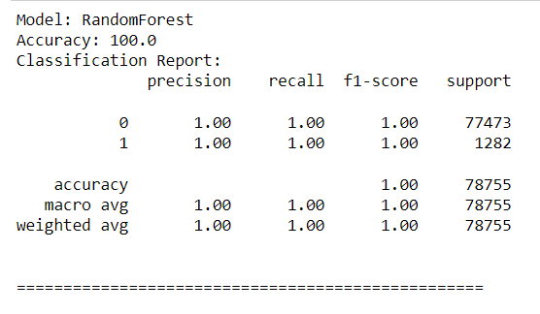
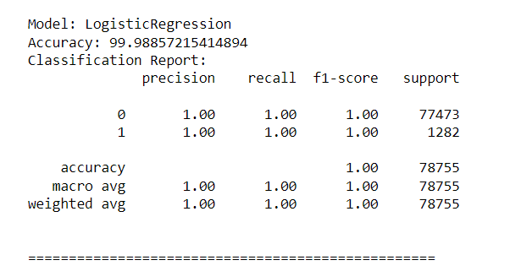
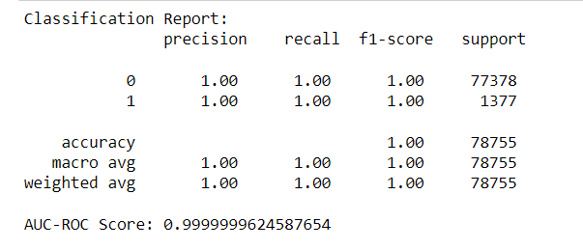
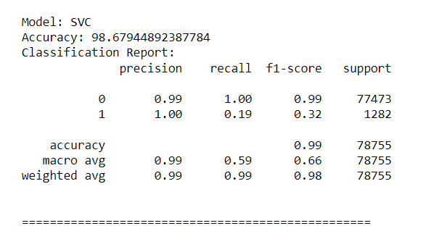
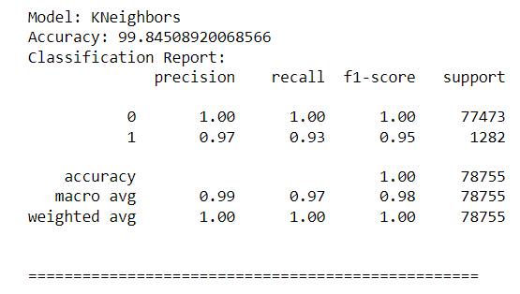
Model Evaluation and Hyperparameter Tuning
Frontier Tech Leaders Programme Global Cohort 1
Evaluation metrics

Slide 19
Model Evaluation and Hyperparameter Tuning
Frontier Tech Leaders Programme Global Cohort 1
Model's performance
All the models performed exceptionally well
While precision was high for KNeighbours, recall and F1-score were slightly lower, indicating some false negatives
The SVC model demonstrates high accuracy but faces challenges in recall and F1-score for class 1.
The high performance however might be an excellent result but there is a risk of overfitting.

Slide 20
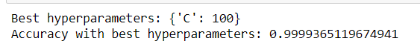
Model Refinement and Testing
Frontier Tech Leaders Programme Global Cohort 1
Refinement phase focused on enhancing model performance, generalization, and robustness.
Addition of new features
Introduction of new algorithms
Oversampling with SMOTE
Cross validation using StratifiedkFold
Hyperparameter tuning
Selection of best models

Slide 21
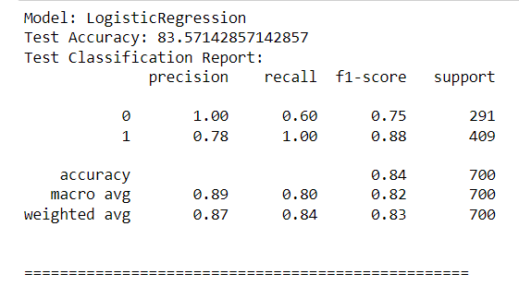
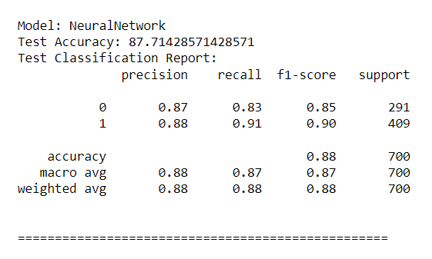
Model Refinement and Testing
Frontier Tech Leaders Programme Global Cohort 1
The test submission phase involves preparing the machine learning model for deployment or evaluation on a test dataset
Preprocess test data
Perform feature engineering
Test the model on test dataset

Slide 22
Results
Frontier Tech Leaders Programme Global Cohort 1

Slide 23
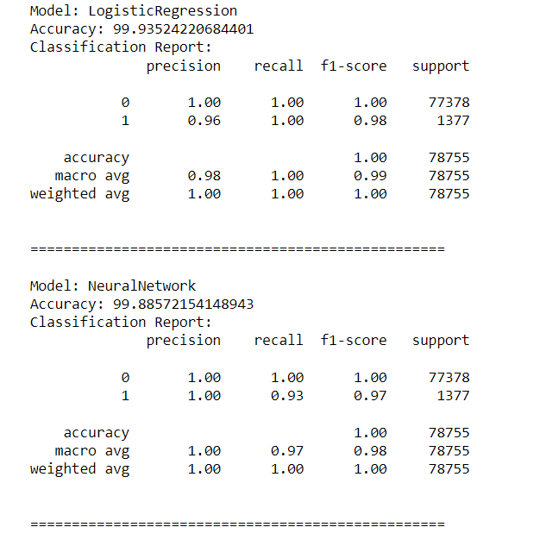
Evaluation Results
Frontier Tech Leaders Programme Global Cohort 1

Slide 24
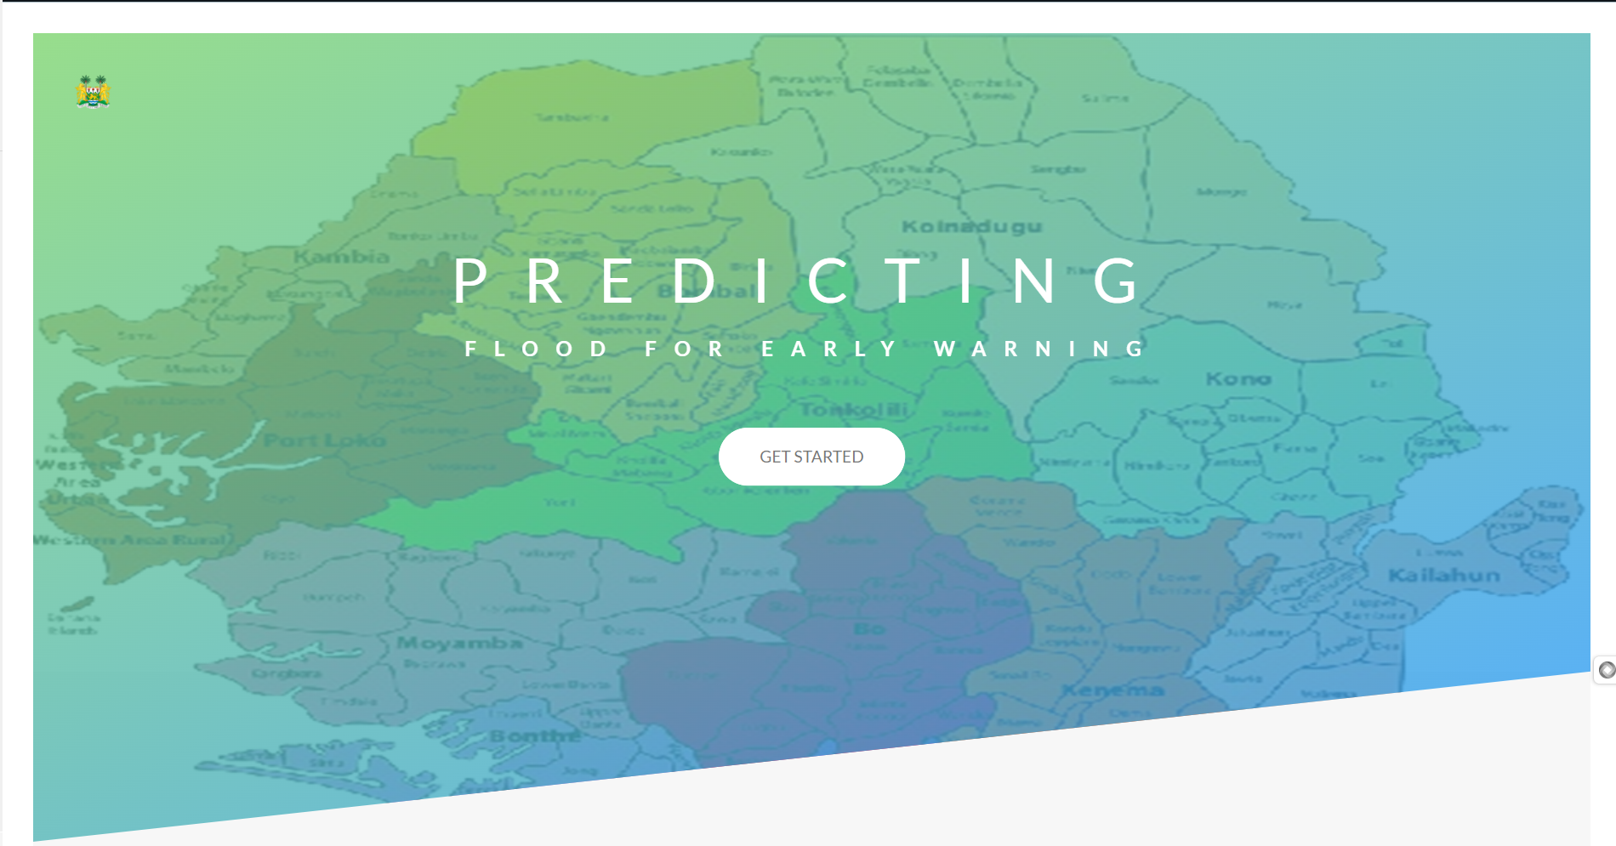
Deployment
Frontier Tech Leaders Programme Global Cohort 1
The purpose of the deployment phase is to make the model available in the real-world for users to make predictions of flood events.
The model was serialized using pickle, served through Flask
Integrated with OpenWeather API to get real-time weather data for prediction

Slide 25


Deployment
Frontier Tech Leaders Programme Global Cohort 1

Slide 26
Future Work
Frontier Tech Leaders Programme Global Cohort 1
Refine model using satellite images coupled with real-time weather data
Allow users to predict for the coming days rather than only predicting the current weather
Integration with weather monitoring stations to provide weather forecasts in addition to predicting flood.
Implement in real-time for early warning and decision making.

Slide 27
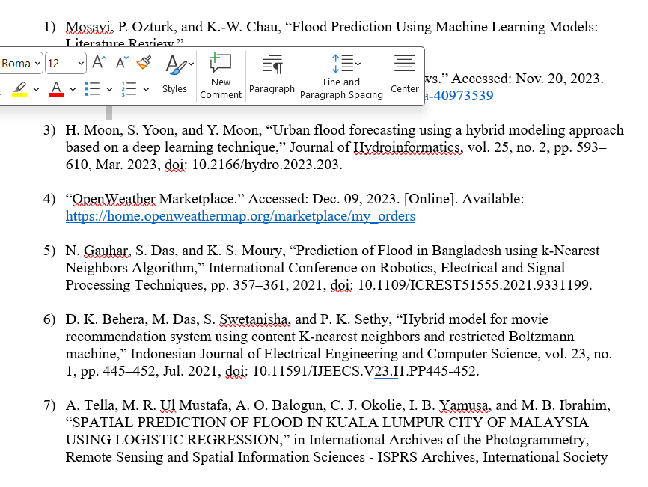
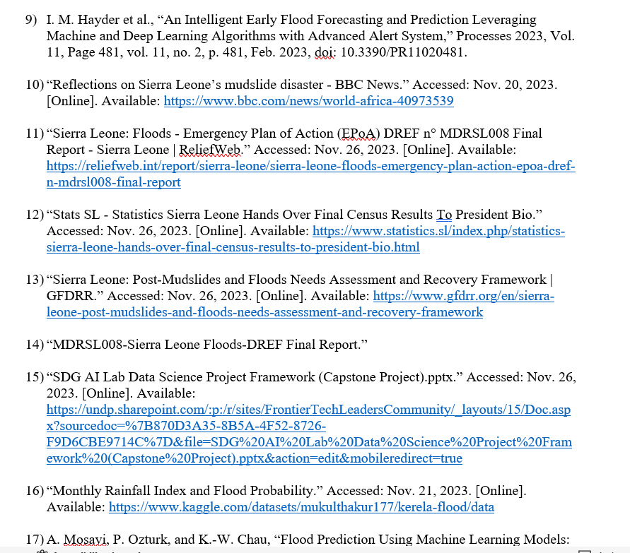
References
Frontier Tech Leaders Programme Global Cohort 1

Slide 28


Thank you!
Frontier Tech Leaders Programme Global Cohort 1

